Slide 1
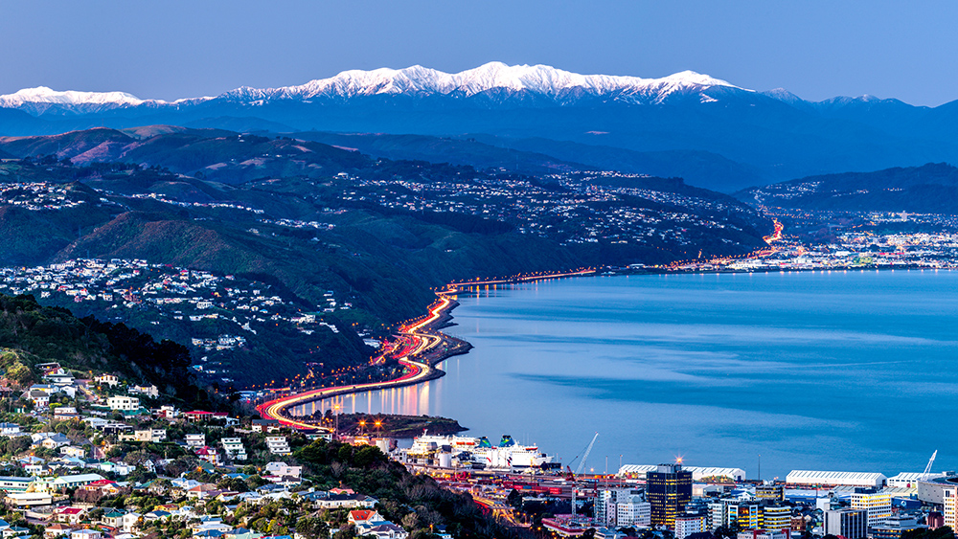
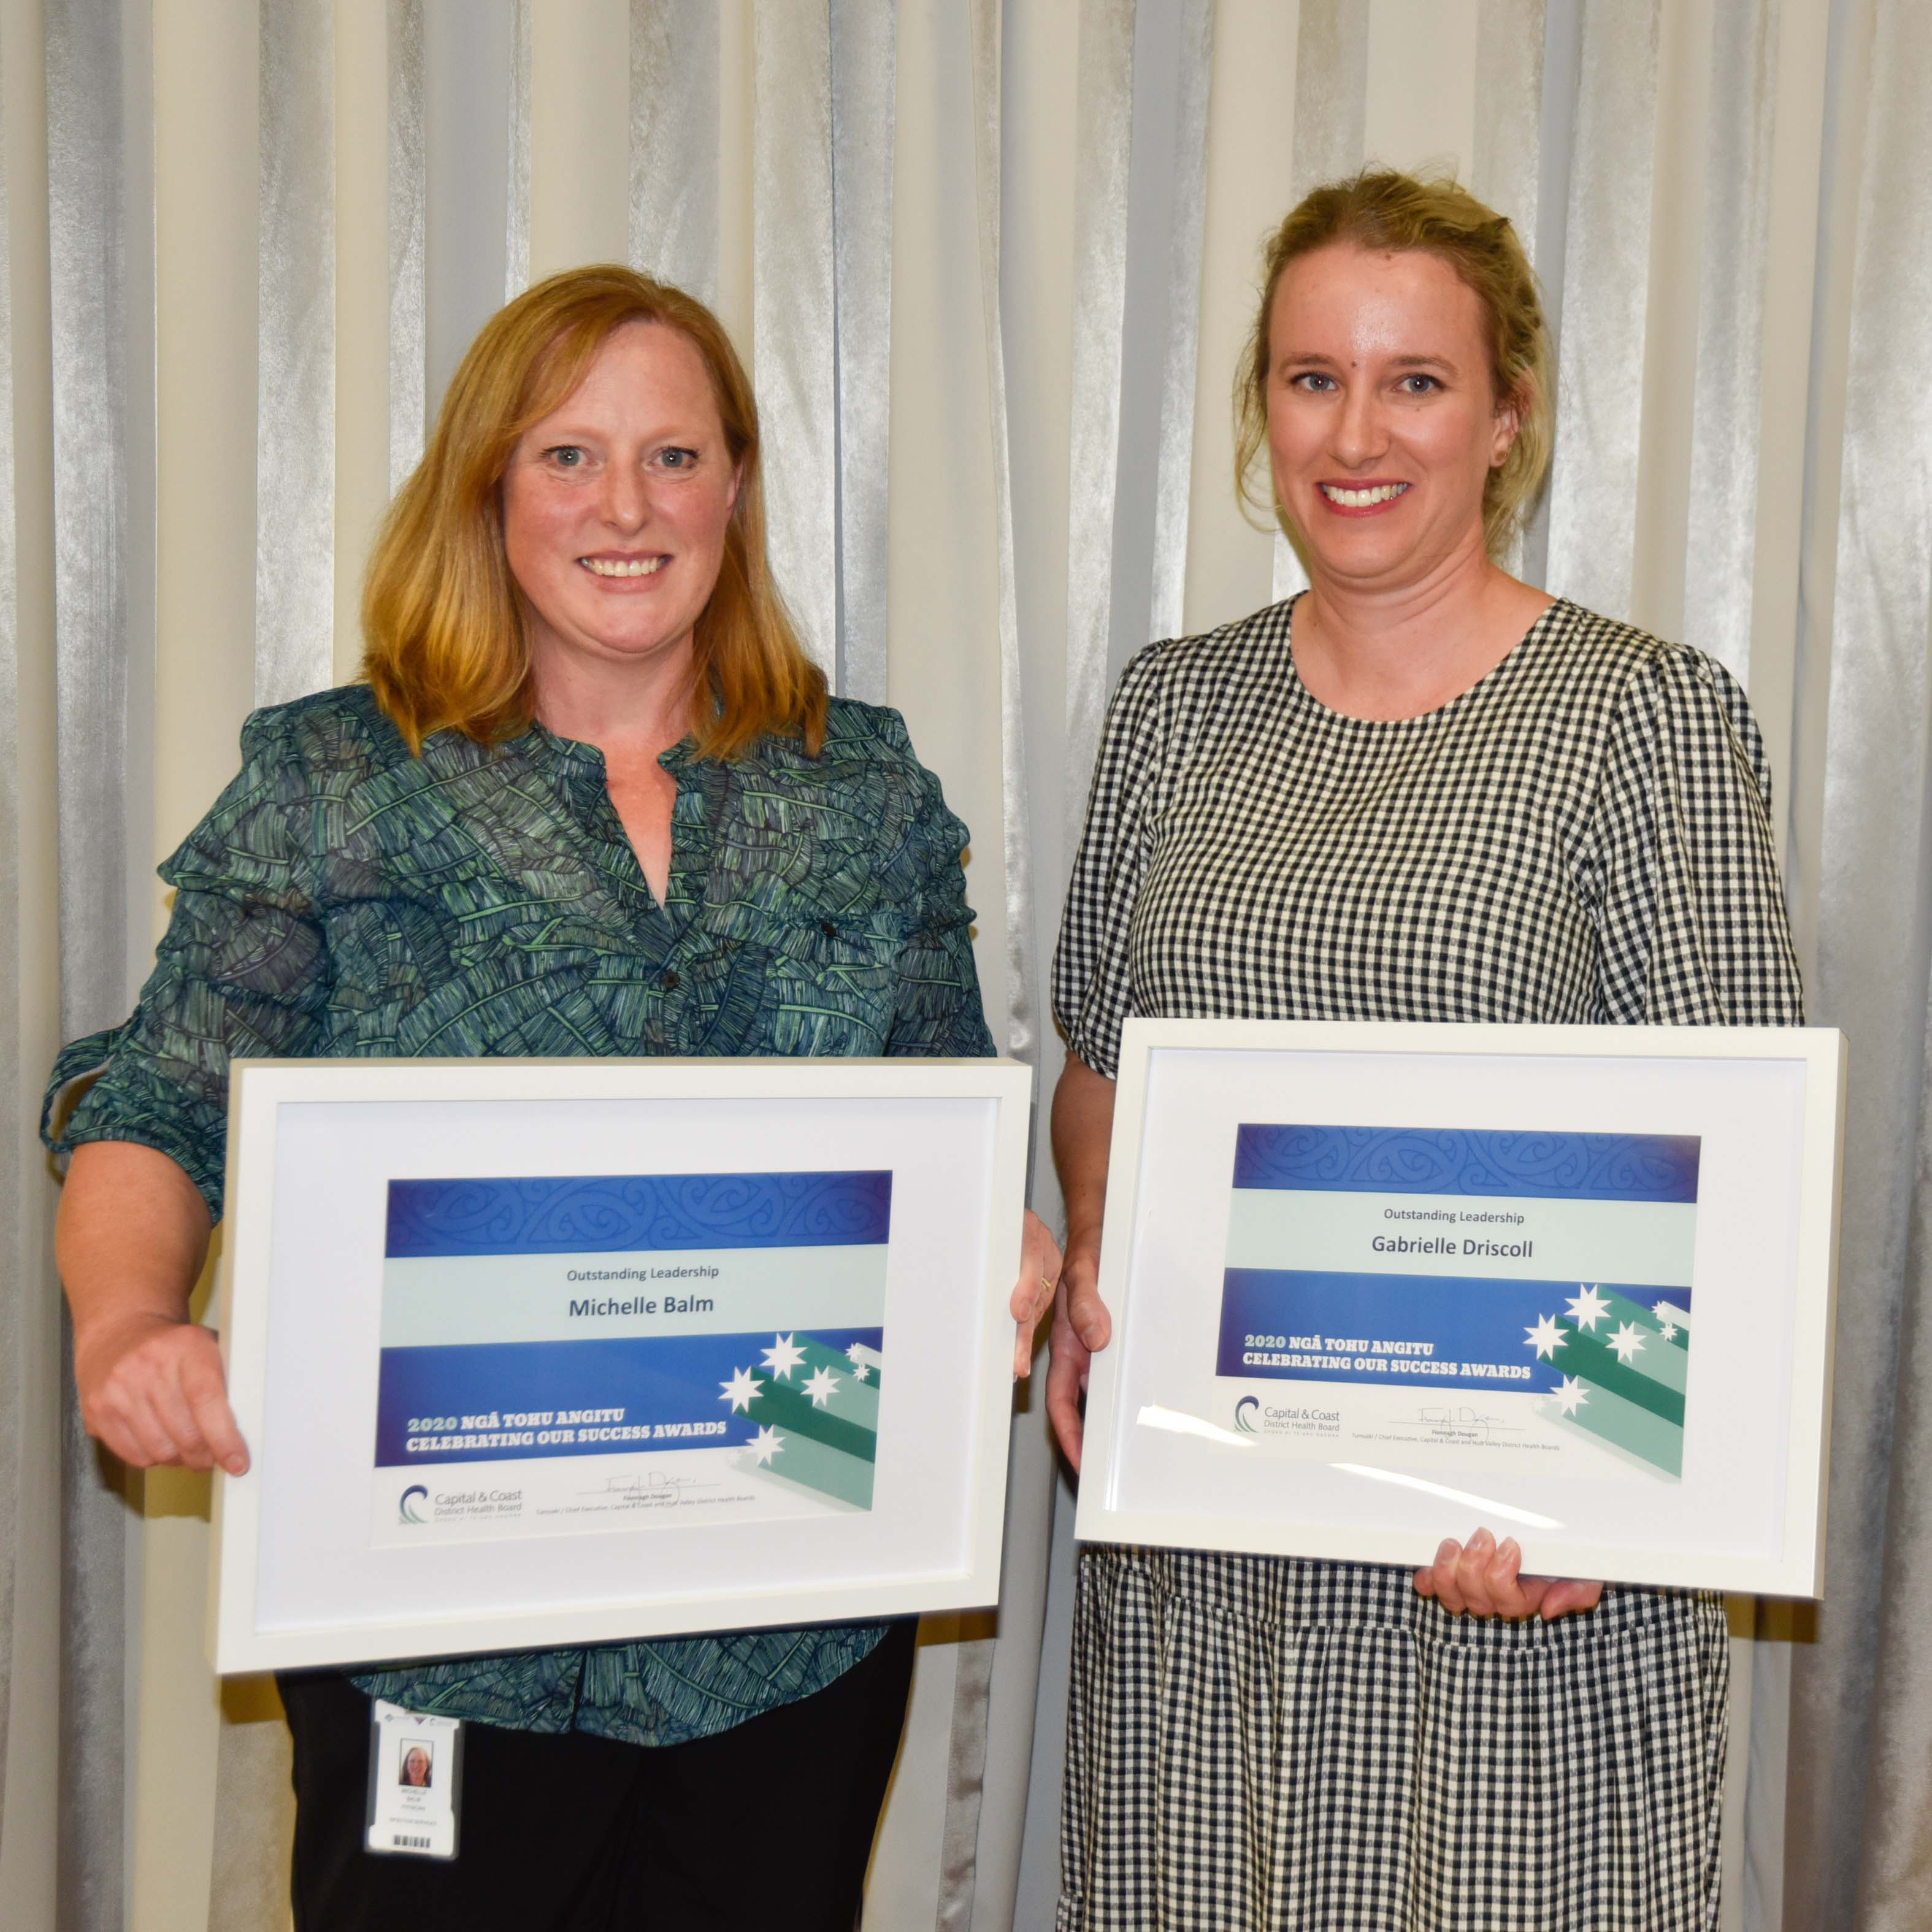
Welcome to the Wellington Region
Wellington Hospital
Kenepuru Community Hospital
Hutt Valley Hospital
Wairarapa Hospital

Slide 2
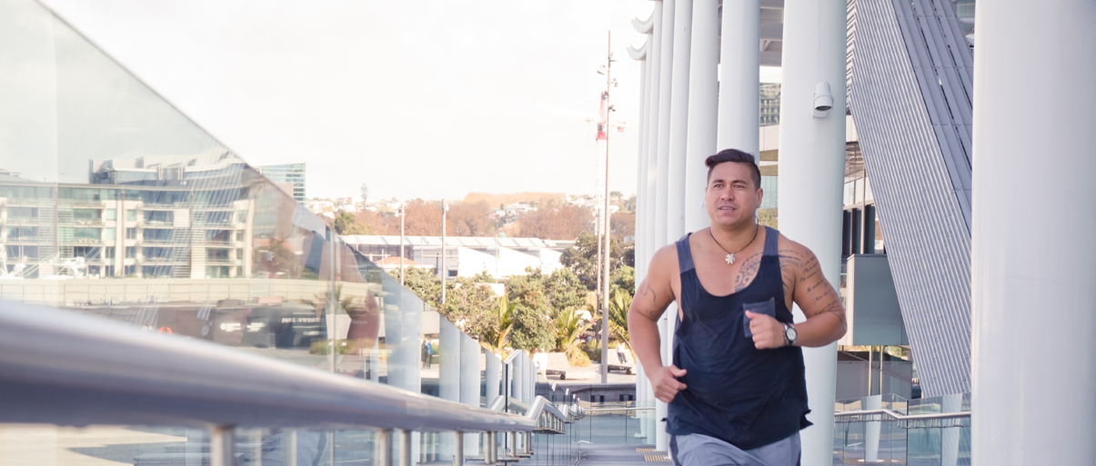
Contents
Introduction to the Panel
Wellington region fast facts
Why work in Wellington region
RMO unit – what we offer
Day in the life of a PGY1
Run options
Application process
Selection criteria
Summary

Slide 3
Introduction to the Panel
RMO Unit Manager
  Susan Andrews
Recruitment Advisers
  Bernadine McGruddy
  Piyasa Konar
Current PGY 2
  Miriam Wilson
Prevocational Education Supervisor
  Alice Stringer
RMO Unit Clinical Adviser
  Dr Christine Mouat

Slide 4

Wellington region – fast facts
Wellington
  Multiple cafes and restaurants
  More coffee shops per capita than New York
  Excellent surfing
  Walking trails close to the city
    Zealandia
  Art and culture meca
    WOW
    NZSO home
    Live theatre / comedy
    Te Papa museum
    Weta workshop
Hutt Valley
  Petone – restaurant heart of the valley
  Beaches, seaside communities
  Art museums, live theatre
  15 minutes from central Wellington
  Good shopping
Wairarapa
  Heart of the wine region
  Vineyard cafes
  Olive groves
  Cycling
  Small towns full of character
  Dark sky region – see the best star constellations

Slide 5
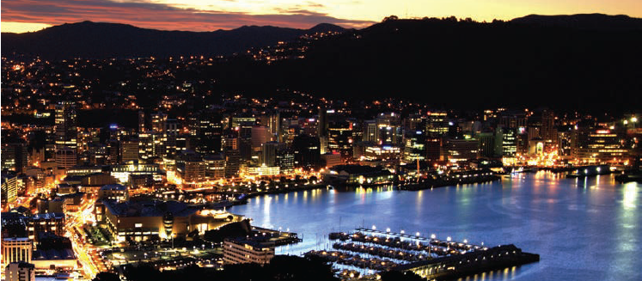
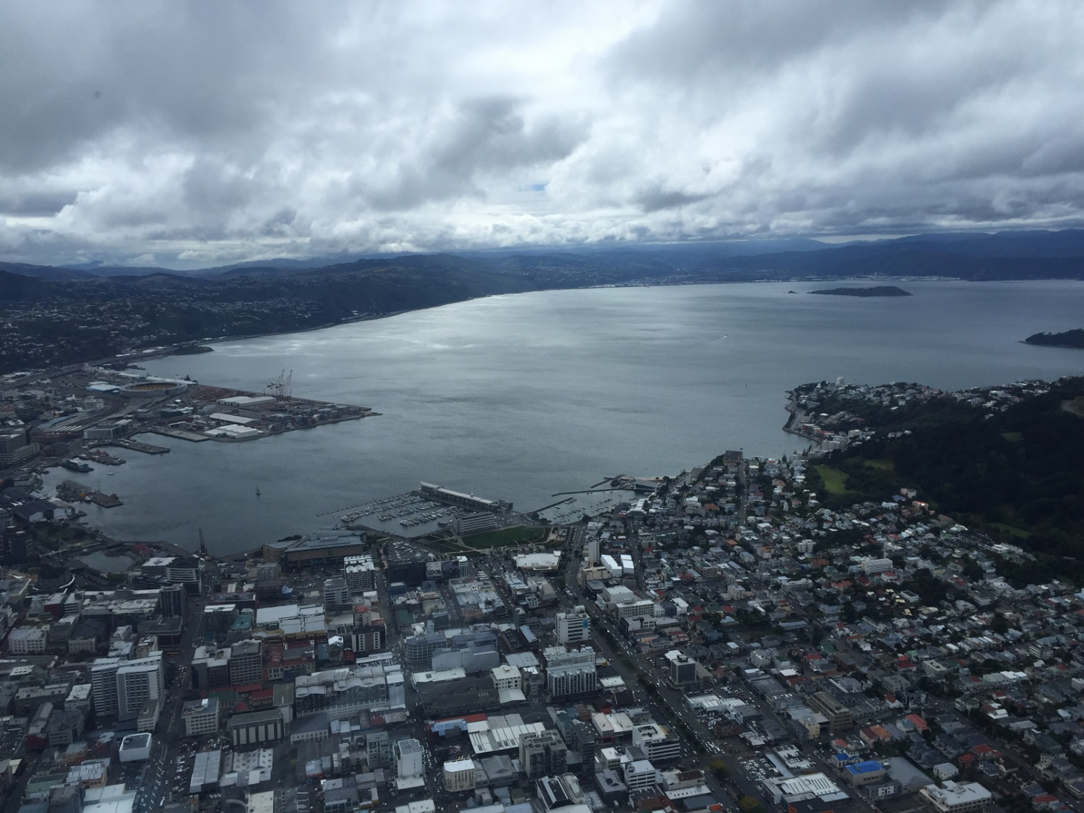
Why work in Wellington
Opportunity to work in 4 different busy dynamic hospitals
National Plastics centre in the Hutt
Robust medical supervision
Sim suite
Well structured and planned post-graduate training for PGY1 House Officers
Ability to complete your entire training in the region
Medical library associated with the Otago campus
Electronic tools to improve workflow and communication - MedApp

Slide 6
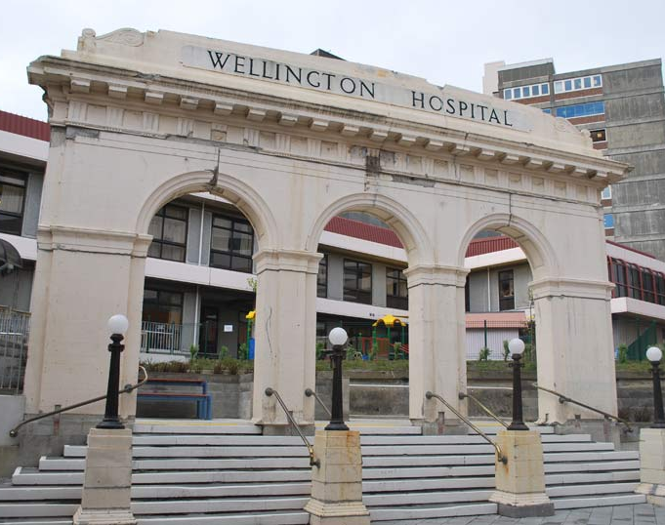
CCDHB & Hutt Valley RMO Unit – what we offer
RMO recruitment for the region
We employ over 600 RMO’s across the region every year
Manage the ACE programme and selection of PGY1 RMO’s for the 3DHB region
Allocates the House Officers into their roles throughout their training
Orientation is undertaken by each RMO unit at each hospital
Rostering –House officers and registrars
Medicine
Surgery
Manage leave and relief pools
Teaching programmes

Slide 7
Run options
First year
Cardiology
Cardiothoracic
Community Based attachments –Community Geriatrics, Addictions
ENT
Gastroenterology
Medicine
Neurosurgery
O & G
Orthopaedics
Plastics
Psychiatry
Rehabilitation
Renal
Respiratory
Stroke / rehab
Surgery – Upper GI/HPB and Gen /Colorectal
Urology
Vascular Surgery
Second year
Anaesthetics
Cardiology
Cardiothoracic
Community Based attachments –Hospice; Addictions; Community Geriatrics, Older Persons rehab
ED
ENT
Gastroenterology
Haematology
Medicine
Neurology
Neurosurgery
Oncology
O & G
Orthopaedics
Paediatrics
Plastics
Psychiatry
Public Health
Rheumatology
Surgery
Urology
Vascular Surgery

Slide 8
Weekly Teaching
Protected teaching time is provided weekly at all hospitals . If you are unable to attend teaching in person as you are working off site it is also available on zoom
Wellington and Kenepuru hospitals Tuesday afternoons 12.00 – 2.00pm
Hutt Tuesday 12.30 - 1.30pm and Friday 8.15am – 9.15am
Wairarapa Wednesday 12.00 – 1.00pm
In addition to the formal weekly PGY1 and PGY2 teaching programmes, all attachments provide weekly specialty specific teaching that the interns attend, for example:
Wellington
Emergency Department Thursday 9-11am
General Medicine Monday 12:30-13:30pm and Thursday 12:30-13:30pm
Respiratory Tuesday 11am-12pm
Cardiology Tuesday 12:30-13:30pm
Ear Nose and Throat Friday afternoon
Vascular Surgery Tuesday morning
General Surgery Friday morning
Haematology Journal club Tuesday 10:30am, Teaching Friday 12:30pm
Oncology Friday 8am
Neurology Friday 9:30pm
Capital and Coast DHB provide and extensive list of additional work based teaching and training that is available to all DHB employees through the “ConnectMe” application. This includes, but is not limited to:
Tikanga Māori
Open communication
Understanding bias in health care

Slide 9
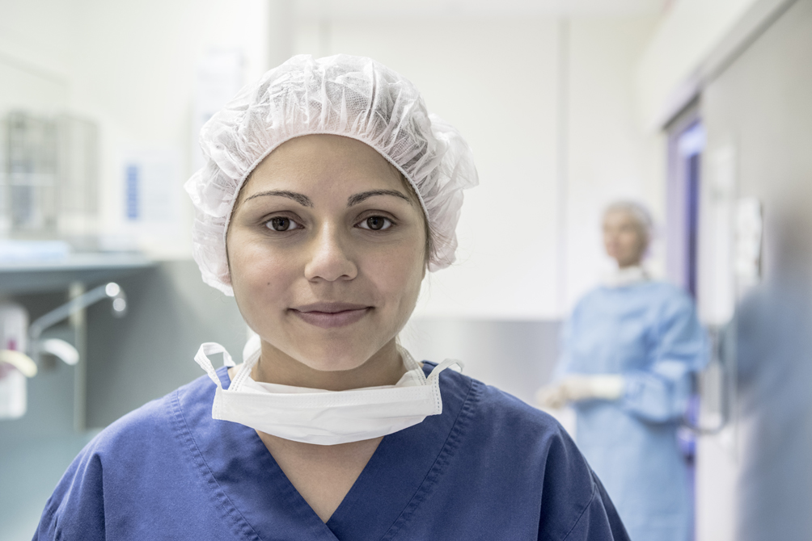
Day in the life of a PGY 1

Slide 10
Application Process
Complete online expression of interest for a telephone interview
https://forms.office.com/r/PnmftCif37
Cover letter to include
  Reasons why you want to come to the region
  Family and friends in the region
  Sporting, community or cultural involvements
  Training opportunities
  Willingness to work in all 3 regional hospitals – Wellington, Hutt Valley and Wairarapa
Full CV or resume to include
  Personal statement
  Scholarships
  Leadership positions
  Academic achievements; prizes; awards, academic transcript
  3 References – very important to us, must be current, don’t leave them to the last minute. Talk with your referees early.

Slide 11

Selection Criteria
Telephone interview
ACE score
Cover letter
Personal statement
CV
References
Commitments in the Wellington region
Family / friends or support in the region

Slide 12
Recruitment Process
RMO unit receives
ACE scores
Your application including CV, Cover letter and References
Ranking of candidates completed and choices made
If matched to the Wellington region you will be contacted by the RMO unit
All offers are made at the same time nationally - Monday 5 September 2022
Please accept your offer as soon as possible.
Last day to accept is Monday 12 September

Slide 13

Summary
What we take into consideration
This could be you next year
Telephone interview
Cover letter
CV or Resume
Personal statement
Non academic achievements
ACE scores
References
Academic transcripts
Interests, community involvements
Ties to the region
Ethnicity
Rank Wellington first if you want to come to us

